Slide 1
Roman

Slide 2
Bellringer
Over the past couple of time periods, what advancements in art have been made?

Slide 3
Roman Period 500 b.c.-a.d. 476
This time period focuses highly on sculpture, however they had many figure paintings as well. They have adopted a love for the nude figure from some Greek artists. Artists of this time period were just broadening their art horizons more and more.
Luxury items of this time period were items such as gem-engraving, metalwork, and glass

Slide 4
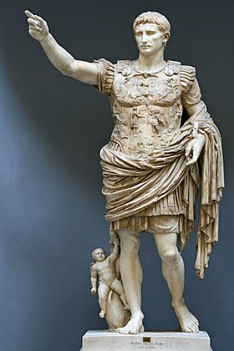
Augustus of Prima Porta
Marble statue of Augustus Caesar
Has Contrapposto
Baby on a dolphin is said to represent his connection to mythology- Venus who is Cupids mother

Slide 5
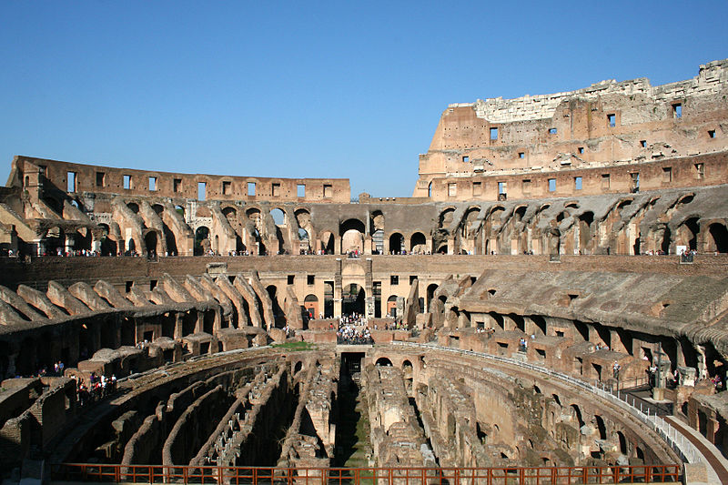
Colosseum
Made out of sand and concrete
Still the biggest amphitheater to this day ever been built
Can hold 50,000 to 80,000 people
Partially damaged by earthquakes and stone robbers

Slide 6
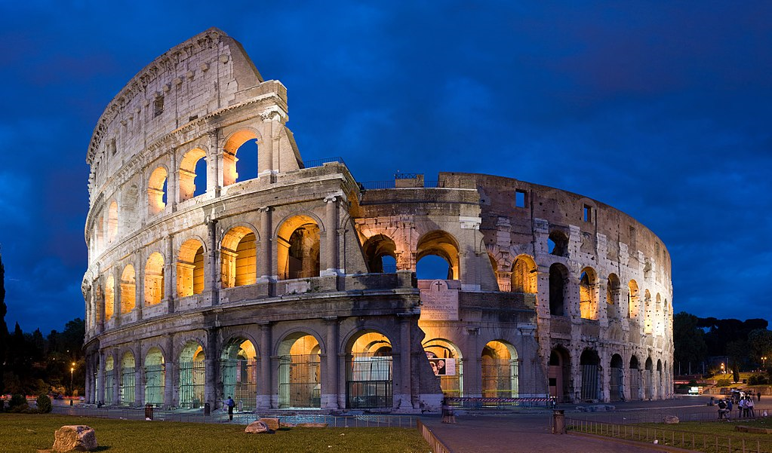

Slide 7
Pantheon
Has high architectural value
Stands as the only unreinforced dome that has not had to be reconstructed
Has stayed in such good shape because of it being used so much throughout history. Now it serves as a church
Do you think a building this valuable should be in this much use?

Slide 8
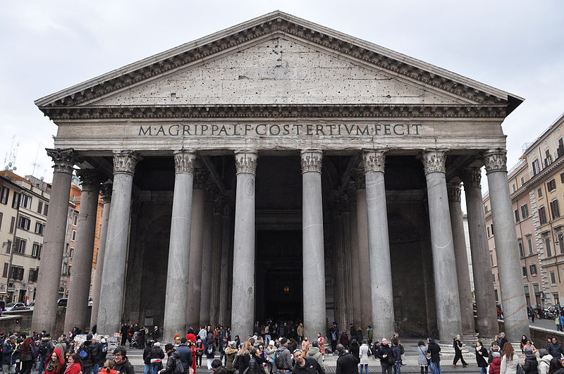

Slide 9
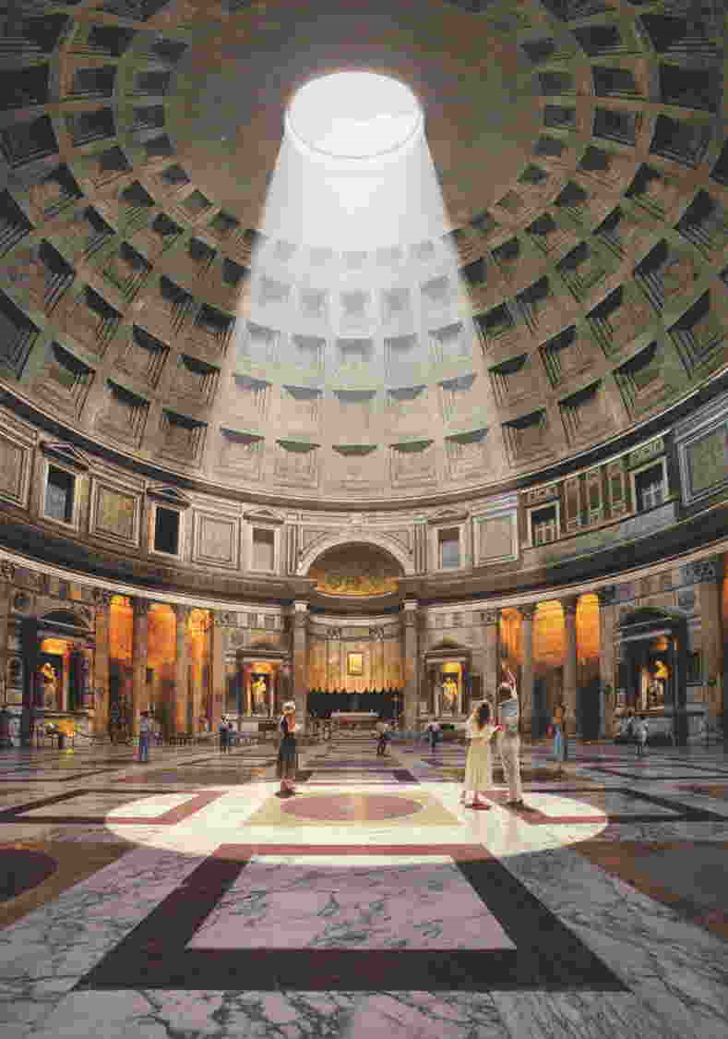

Slide 10
